Slide 1
Task Management Application
Ali W. Abbas
Supervised by: Dr. Shaymaa Waleed Al-Shammari

Slide 2
Outline
Introduction
Aim
Features
Development Tool
Essential Operation
Security Implementation
DB Schema
Gantt Chart

Slide 3

Introduction
The Task Management System is a web app that helps teams plan, execute, and monitor projects. It centralizes collaboration, task assignment, progress tracking, and resource management and ensure timely, budget-friendly project completion.

Slide 4
Aim
To develop a scalable, reliable, fast, and efficient application to manage projects, assign tasks, track progress, and improve team collaboration while securely storing project data in a relational database.

Slide 5
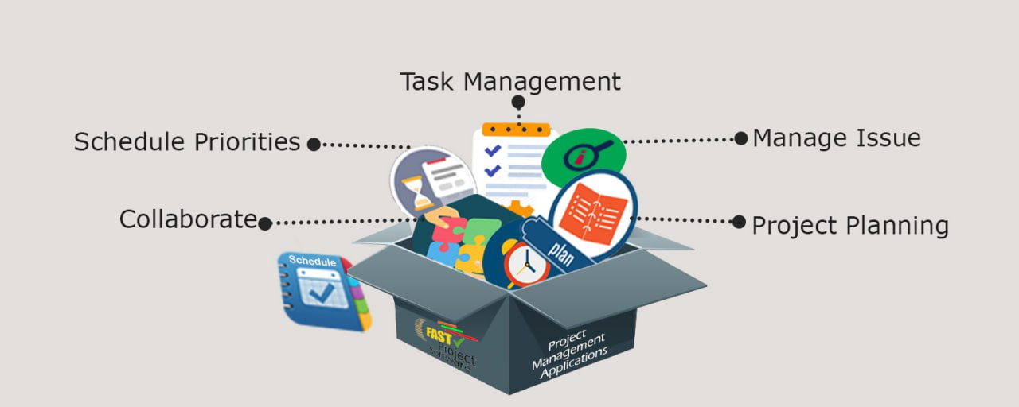
Features
Task management
Time tracking
Project scheduling
Communication
Reporting
SECURED

Slide 6






Development Tools
React :A JavaScript library for building dynamic and interactive user interfaces
Tailwind :CSS framework Used for designing and styling web pages
Axios :A library for making HTTP requests to communicate with the backend API
HTML :The standard markup language for structuring web pages.
React Router : helps handle routing between different pages in the app
Socket.io (client-side): Socket.io is essential for enabling real-time

Slide 7





Development Tools
Express.js :use d for building the server-side of the application
PostgreSQL :A powerful and reliable relational database for storing project data
JWT :JWT is used for user authentication, securing the app, and managing sessions
WebSocket :Enables real-time communication between the server and clients
RESTful API :is an architectural style for an application programming interface that uses HTTP requests to access and use data

Slide 8
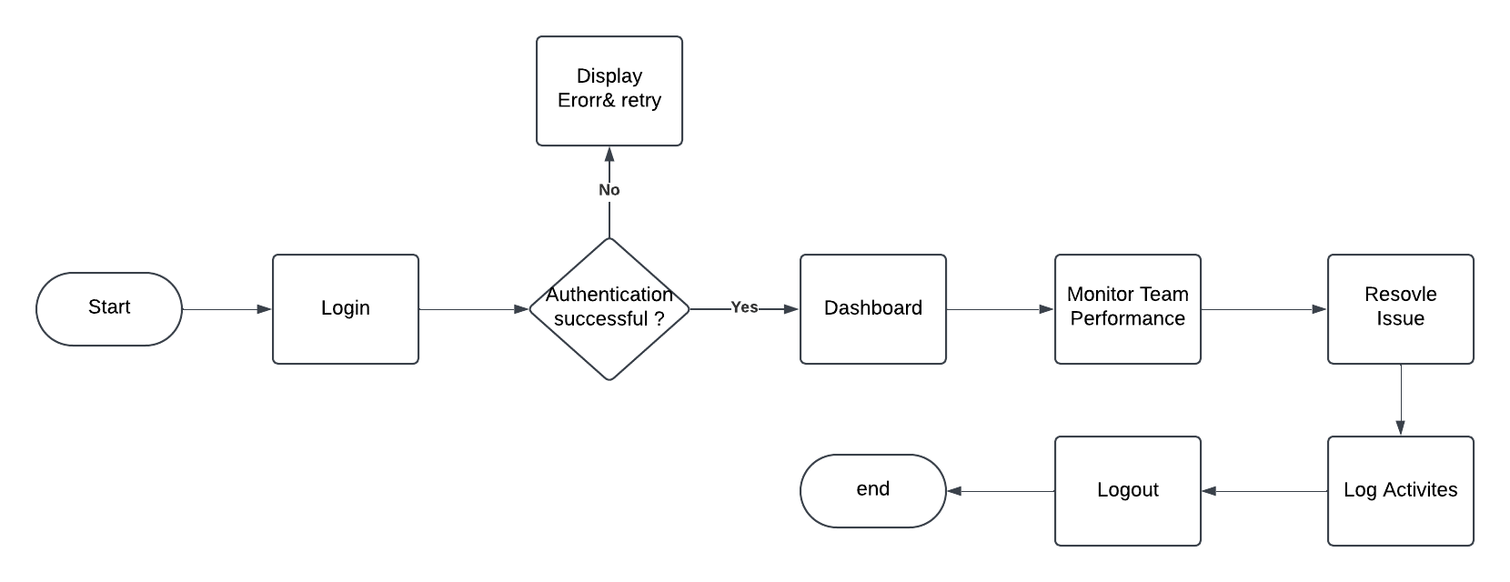
Admin Operation

Slide 9
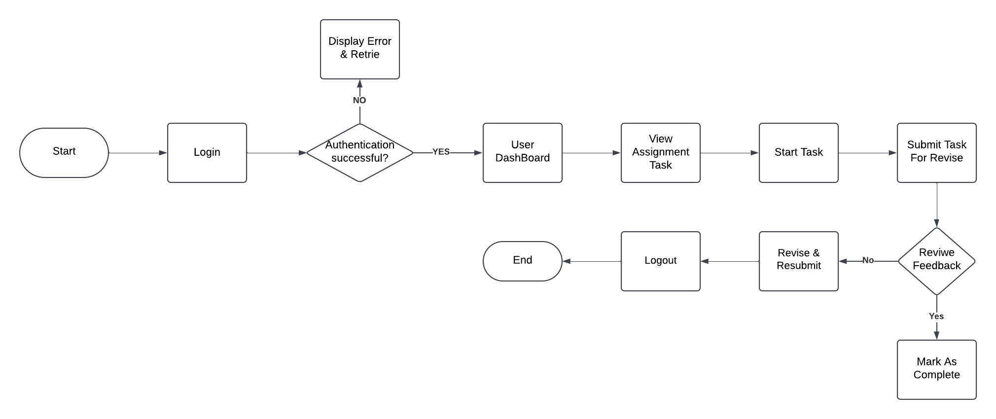
User Operation

Slide 10
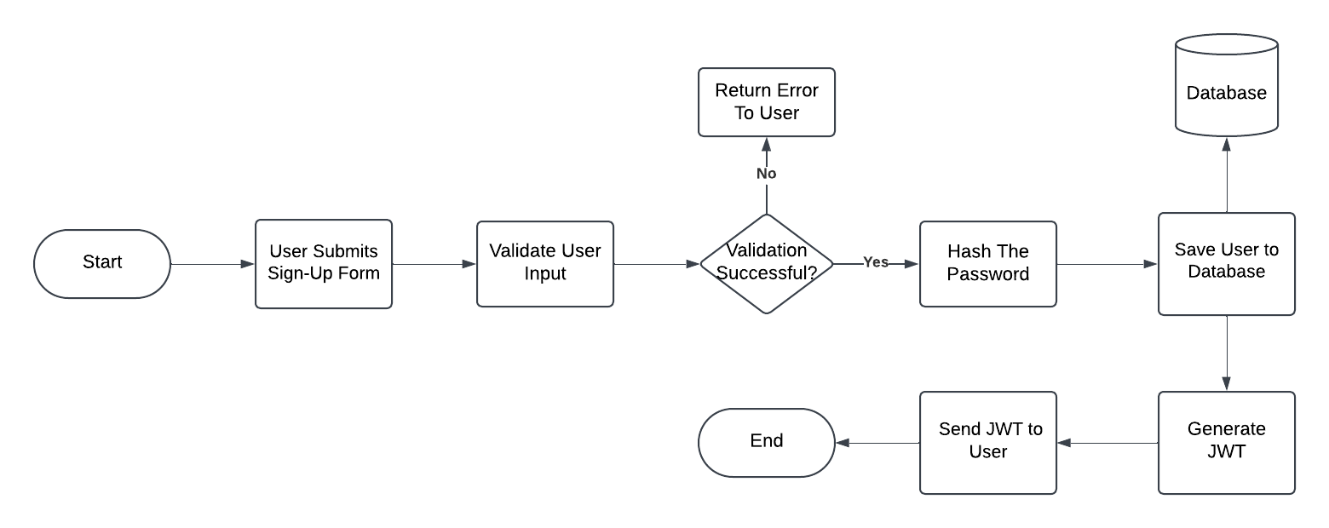
Authentication Process

Slide 11



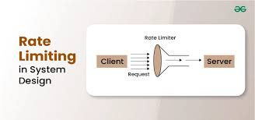


Security Implementation
CORS : Controls which domains can access resources
Protected Middleware : ensure only valid users can access secured routes.
Blacklist : Invalidates JWTs after logout to prevent reuse of tokens by attackers.
Rate Limit : Restricts the number of requests from a user in a specific timeframe to prevent brute force
Token Expire : Sets an expiration time for JWTs
Environment Variables : Secures sensitive data like API keys and passwords
Together, these measures provide a good approach to securing our application

Slide 12
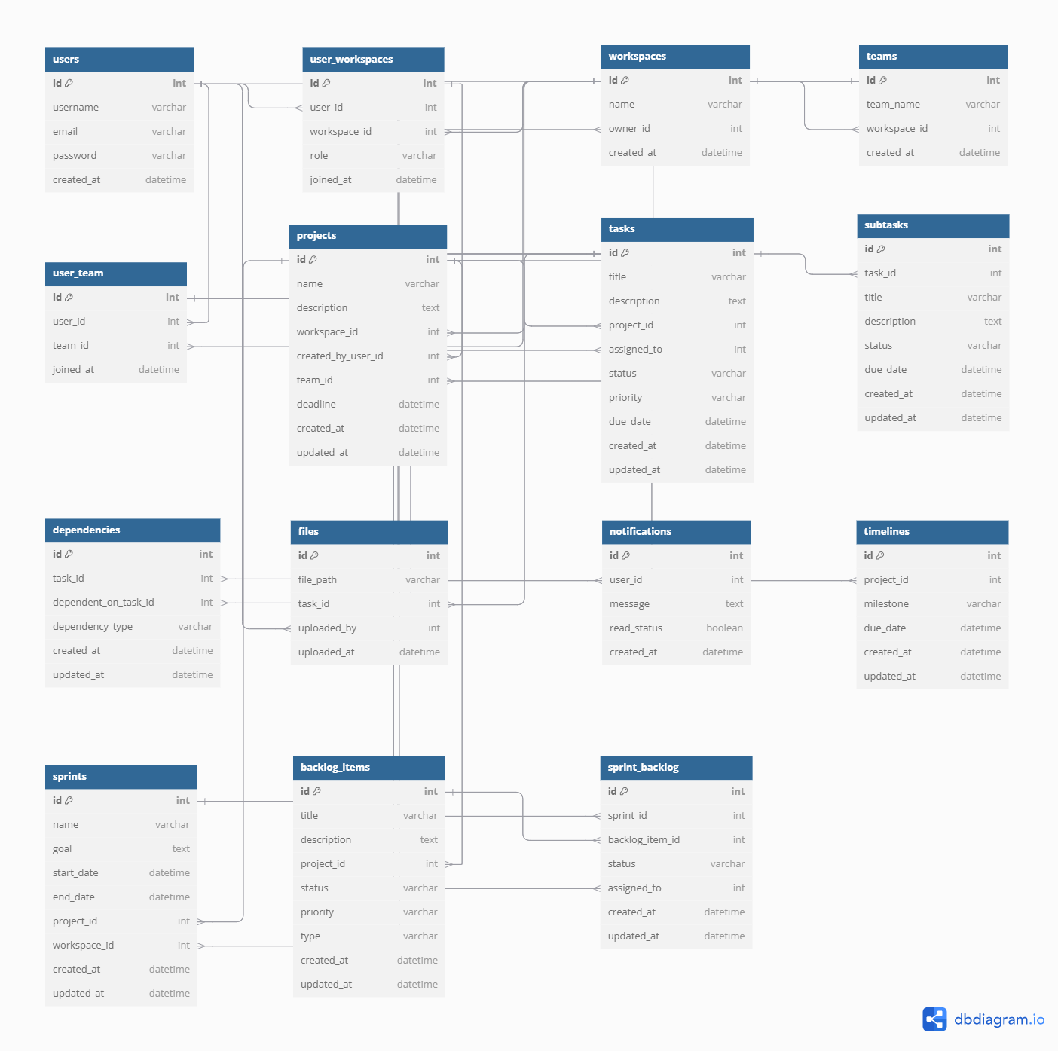
DB Schema

Slide 13
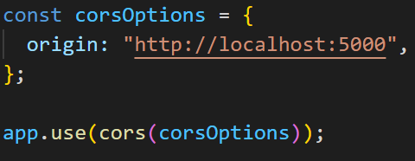
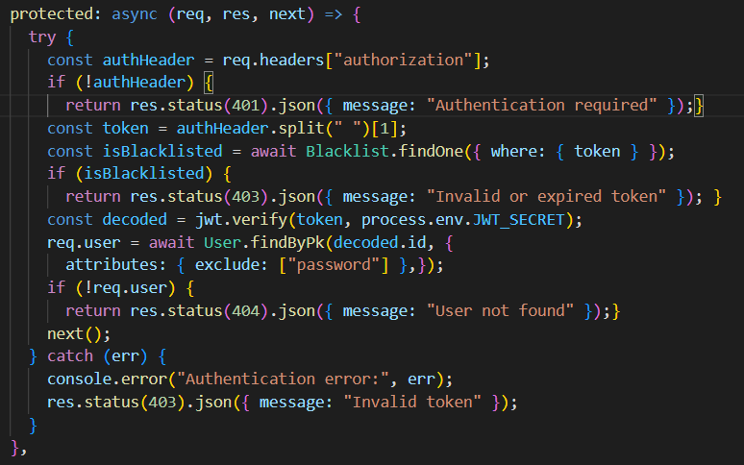
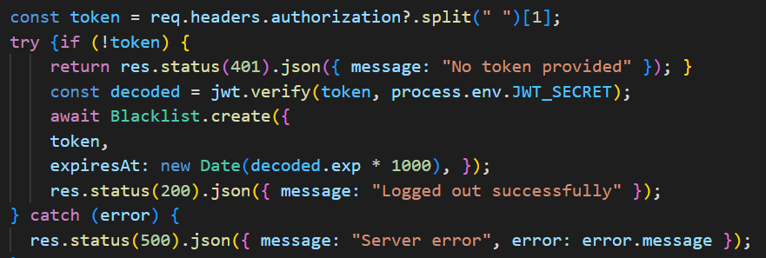
System Implementation
CORS
Protected Middleware
Add Token to BlackList

Slide 14
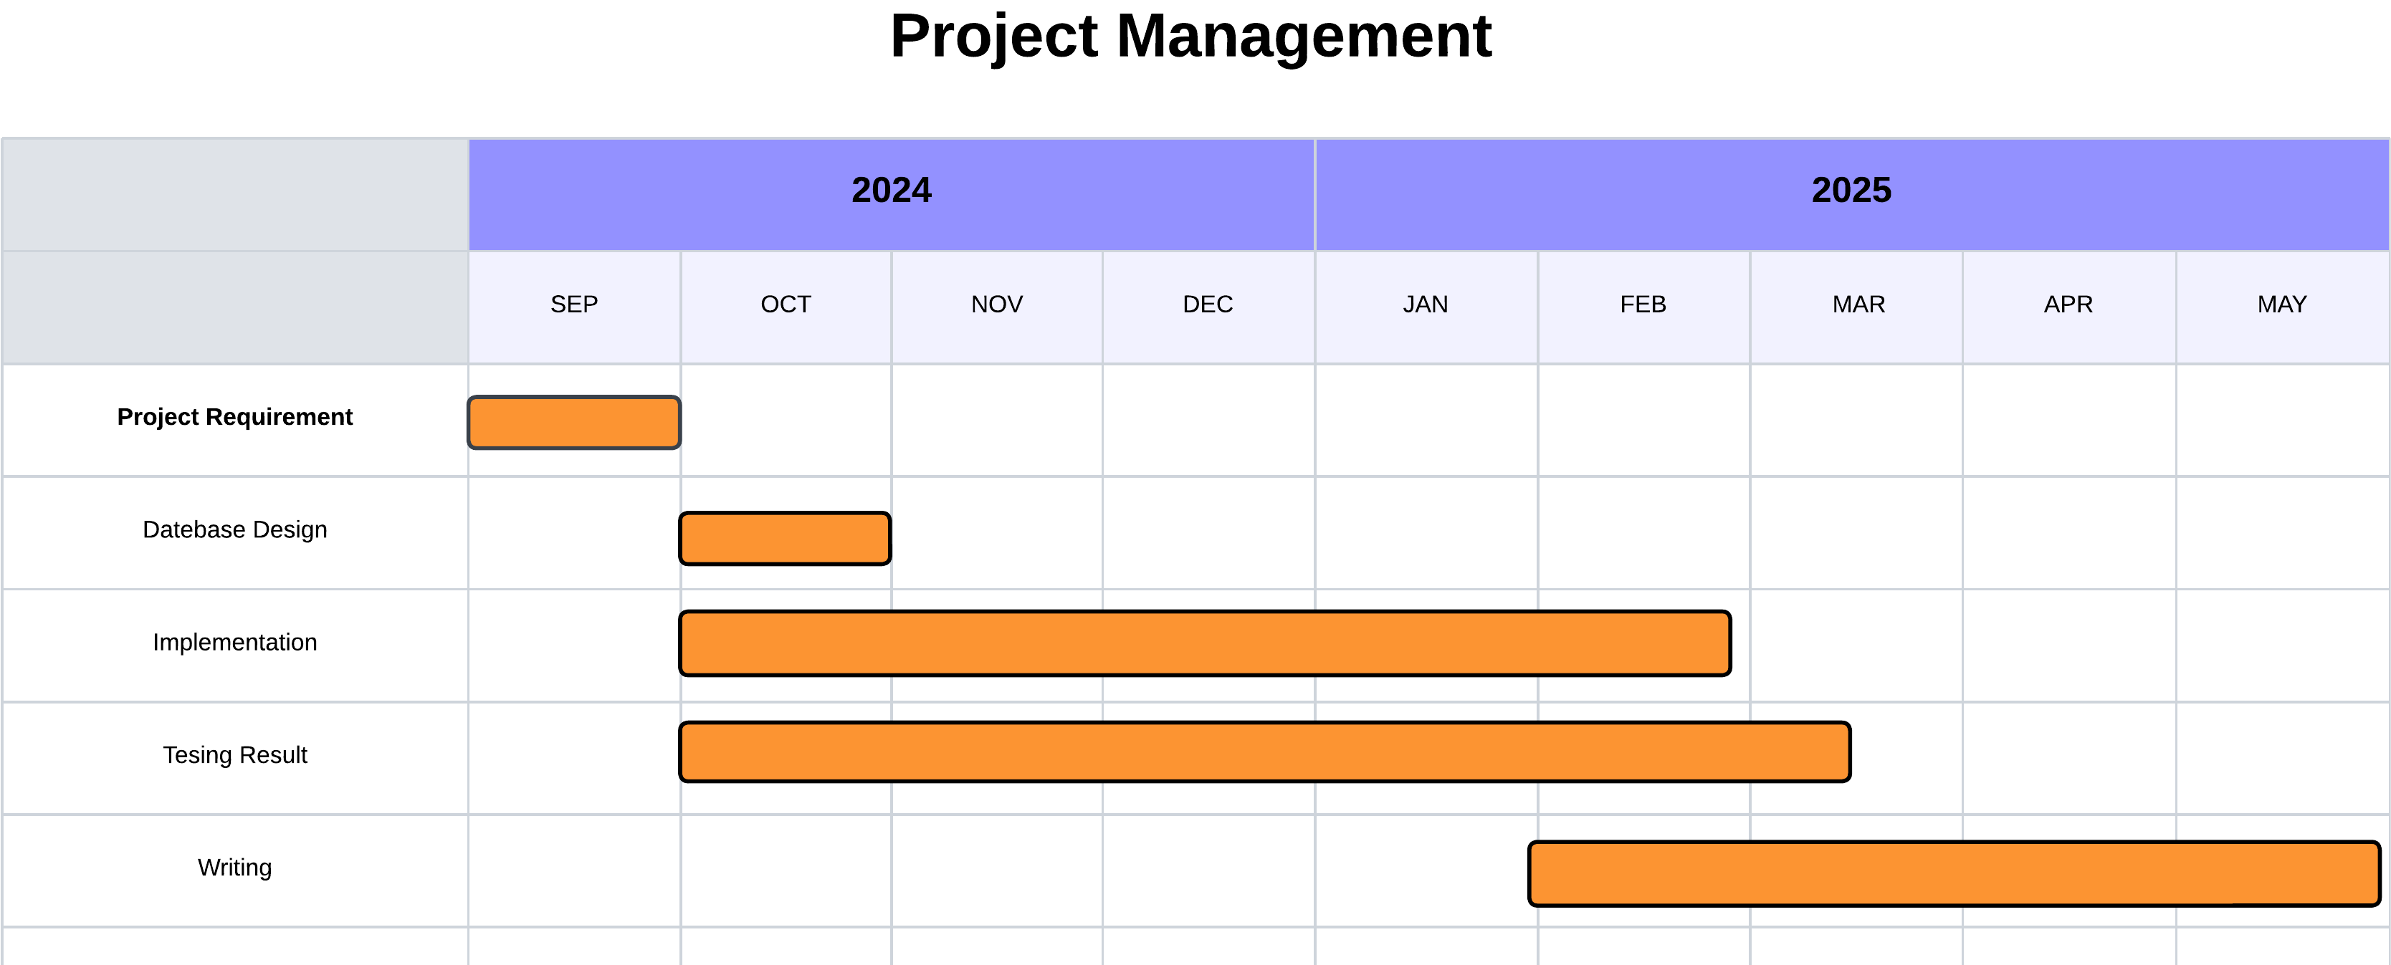
Gantt Chart

Slide 15
Thank you for listening

